Slide 1
Employee Data Analysis using Excel
STUDENT NAME:ABINAYA.B
REGISTER NO: 312209804
DEPARTMENT: B.com Computer Application
COLLEGE: Anna Adarsh College for Women

Slide 2
PROJECT TITLE
Employee Salary Analysis using Excel

Slide 3


AGENDA
Problem Statement
Project Overview
End Users
Our Solution and Proposition
Dataset Description
Modelling Approach
Results and Discussion
Conclusion
3/21/2024 Annual Review

Slide 4

PROBLEM STATEMENT
Analysis of employee salary based on their FTE or also know as work done and type of employee like fixed ,temporary and permanent worker
In essence it is on how employee salary is affected by FTE and employee type
It Enhancing Productivity
Informed Decision making
Helps in Identifying trends and patterns

Slide 5

PROJECT OVERVIEW
Employee salary analysis based on various factors like Gender, FTE, Type of employment of an particular person . By which we analyse the various trend patterns on salary like how it varies from one person to another based on specific conditions whether these conditions are helpful for a person to achieve higher salary and so on. For ex: permanent workers their work performance and in turn what their salary is credited according to it and so on.

Slide 6
PROJECT OVERVIEW
Salary analysis is important for various factors like:
Feedback and improvement
Goal setting
Career development
Increased Productivity
Employee retention and so on

Slide 7

WHO ARE THE END USERS?
Employees
Employers
Managers
Shareholders
Investors
Creditors
Public in general

Slide 8
OUR SOLUTION AND ITS VALUE PROPOSITION
Conditional Formatting – To find missing and null values
Pivot table – Summarise the necessary data
Slicer – To differentiate how Data changes based on certain conditions like gender
Graph Data- visualisation of data trends
Formula - To convert numeric FTE into a set of standards

Slide 9
Dataset Description
Employee Data set – Downloaded from Skills build Edunut
Total 26 features and used 6 features
Name – Name of Employee in text
Gender – A code representing gender of an employee that is male or female
Salary – Numeric salary of an particular employee
Work Level - Contains FTE level like excellent, average and medium
Employee type – Code containing types of employee whether fixed , permanent or temporary.

Slide 10

THE "WOW" IN OUR SOLUTION
WORK LEVEL =IFS($F2>=0.7,"EXCELLENT",$F2>=0.4,"AVERAGE",$F2>=0.1,"MEDIUM",TRUE,"LOW")
FORMULA TO Calculate Work Level
10

Slide 11
MODELLING
Data collection:
Downloaded the dataset from edunet dashboard and then opened the data in excel.
Feature collection:
To choose the specific columns of choice like Name, Salary , Gender, Work level , Employee type and FTE according to needs.
Data cleaning:
To filter the columns and rows using conditional formatting and find the null and blank values and then remove them from the data list to finalize the set of data being used for analysis
11

Slide 12
MODELLING
Work level: To calculate work level you need to use this formula to the FTE column ==IFS($F2>=0.7,"EXCELLENT",$F2>=0.4,"AVERAGE",$F2>=0.1,"MEDIUM",TRUE,"LOW").
According to which if the FTE is between 0.1 to 0.4 it is considered medium and 0.4 to 0.7 is average and 0.7 and above is Excellent work performance
SUMMARY: Now an pivot table is created using the Columns and rows that is name, salary , work performance , gender and employee type .After the creation of pivot table an slicer is created on types of employee Fixed , temporary and permanent employee following which the graph is created.

Slide 13
MODELLING
Graphical representation:
After the creation of pivot table there is graphical representation which is done through bar charts. 3 bar charts are created first one is based on employee salary analysis based on Work Level and Fixed employee , then the second one is created on employee salary and Work Level and Temporary employee and the final bar graph is based on permanent employee.

Slide 14
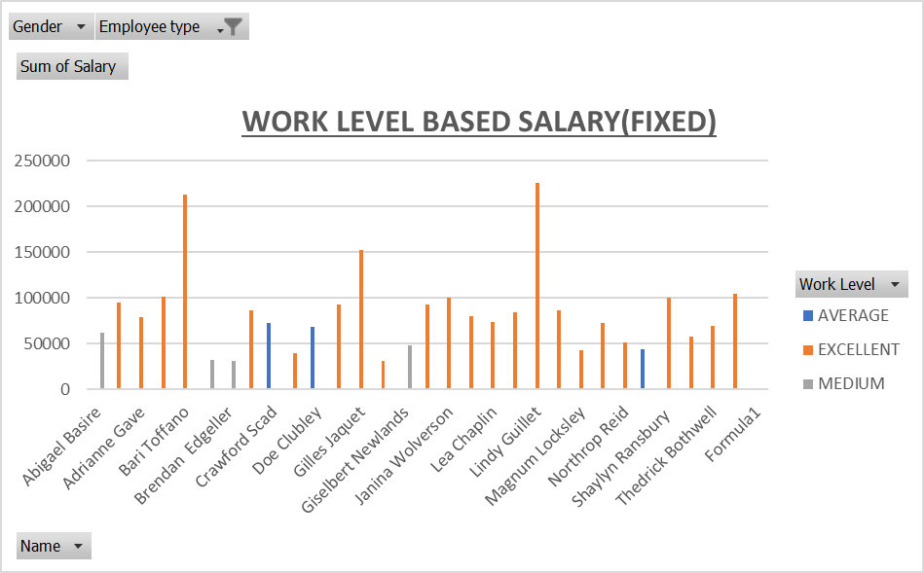
RESULTS
14

Slide 15
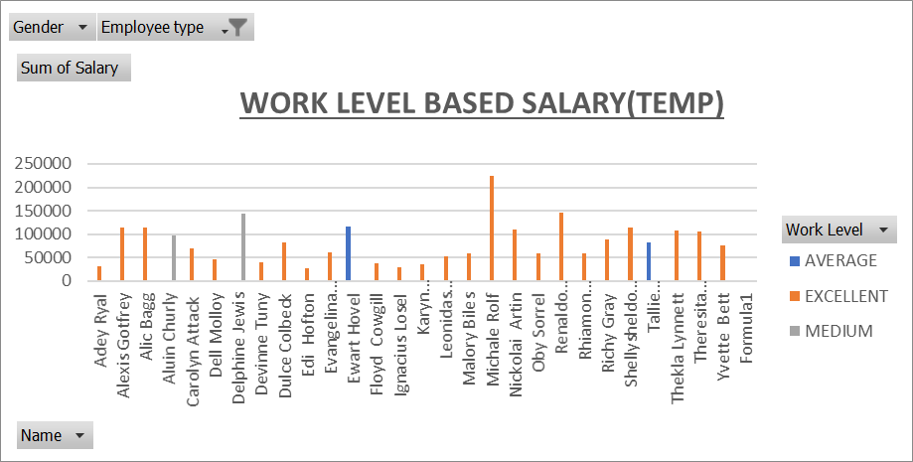
RESULTS

Slide 16


Slide 17
Conclusion
Through this analysis of salary of workers based on their work performance helps us understand how the employee type affects the works performance which in turns affects the salary of an employee.
As you see in the graphs permanent employees have better work performance which in turn boosts up their salary compared to fixed and temporary workers whereas the temporary workers have least amount of salary and work performance.

